Slide 1
















1

Slide 2
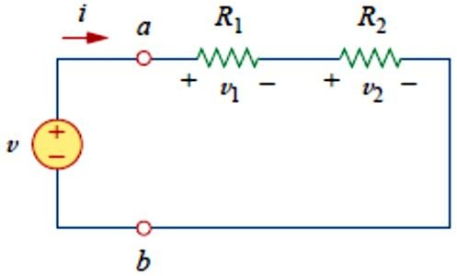
2
2-9 Series Resistors and Voltage Division
The need to combine resistors in series or in parallel occurs so frequently
that it warrants special attention. The process of combining the resistors is facilitated by combining two of them at a time. With this in mind, consider the single-loop circuit of Fig. 1. The two resistors are in series, since the same current 𝑖 flows in both of them.
Fig. 1 A single-loop circuit with two resistors in series.
Applying Ohm’s law to each of the resistors, we obtain
𝑣₁ = 𝑖𝑅₁, 𝑣₂ = 𝑖𝑅₂ (1)
If we apply KVL to the loop (moving in the clockwise direction), we have
−𝑣 + 𝑣₁ + 𝑣₂ = 0
(2)
Combining Eqs. (1) and (2), we get
𝑣 = 𝑣₁ + 𝑣₂ = 𝑖(𝑅₁ + 𝑅₂)
(3)
Or
𝑖 = _{𝑅}
𝑣
(4)
1
+ 𝑅
2

Slide 3
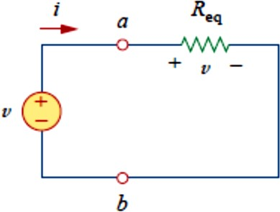
3
Notice that Eq. (3) can be written as
𝑣 = 𝑖𝑅_{𝑒𝑞} (5)
implying that the two resistors can be replaced by an equivalent resistor
𝑅_{𝑒𝑞} ; that is,
𝑅_{𝑒𝑞} = 𝑅₁ + 𝑅₂ (6)
Thus, Fig. 1 can be replaced by the equivalent circuit in Fig. 2. The two
circuits in Figs. 1 and 2 are equivalent because they exhibit the same voltage-current relationships at the terminals a-b. An equivalent circuit such as the one in Fig. 2 is useful in simplifying the analysis of a circuit.
Fig. 2 Equivalent circuit of the Fig. 1 circuit
In general,
The equivalent resistance of any number of resistors connected in series is the sum of the individual resistances.
For N resistors in series then,
𝑁
𝑅_{𝑒𝑞} = 𝑅₁ + 𝑅₂ + ⋯ + 𝑅_{𝑁} = ∑ 𝑅_{𝑛}
𝑛=1
(7)
To determine the voltage across each resistor in Fig. 1, we substitute Eq.
(3) into Eq. (1) and obtain
𝑣 =
𝑅₁
𝑅 + 𝑅 ^{𝑣,}
1 2
𝑣₂ = _{𝑅}
𝑅₂
+ 𝑅
𝑣 (8)
1
1 2
Notice that the source voltage 𝑣 is divided among the resistors in direct proportion to their resistances; the larger the resistance, the larger the

Slide 4
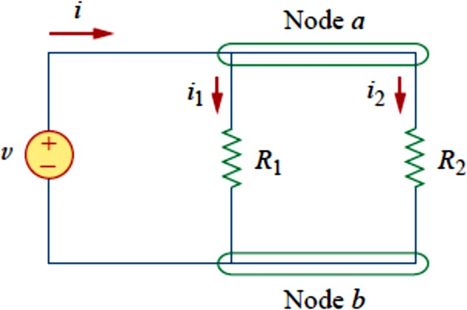
4
voltage drop. This is called the principle of voltage division, and the circuit in Fig. 1 is called a voltage divider. In general, if a voltage divider has N resistors (𝑅₁, 𝑅₂, … , 𝑅_{𝑁}) in series with the source voltage 𝑣, the nth resistor (𝑅_{𝑛} ) will have a voltage drop of
𝑣 =
𝑅_{𝑛}
𝑣 (9)
𝑛
𝑅₁ + 𝑅₂ + ⋯ + 𝑅_{𝑁}
2-10 Parallel Resistors and Current Division
Consider the circuit in Fig. 3, where two resistors are connected in parallel and therefore have the same voltage across them.
Fig. 3 Two resistors in parallel.
From Ohm’s law,
𝑣 = 𝑖₁𝑅₁ = 𝑖₂𝑅₂
Or
𝑣
𝑣
𝑅
𝑖 = ,
𝑖 =
(10)
1
𝑅
2
1 2
Applying KCL at node a gives the total current 𝑖 as
𝑖 = 𝑖₁ + 𝑖₁
(11)
Substituting Eq. (10) into Eq. (11), we get
𝑣 𝑣 1 1 𝑣
(12)
𝑖 = _{𝑅} + _{𝑅} = 𝑣 (_{𝑅} + _{𝑅} ) = _{𝑅}
1
2
1
2
𝑒𝑞

Slide 5
5
Where 𝑅_{𝑒𝑞} is the equivalent resistance of the resistors in parallel:
1 1 1
𝑅
𝑒𝑞
= _{𝑅} + _{𝑅}
(13)
1
2
Or
1 𝑅₁ + 𝑅₂
=
^{𝑅}𝑒𝑞
𝑅₁𝑅₂
Or
𝑅 =
𝑅₁𝑅₂
(14)
𝑒𝑞
𝑅₁ + 𝑅₂
Thus,
The equivalent resistance of two parallel resistors is equal to the product of their resistances divided by their sum.
It must be emphasized that this applies only to two resistors in parallel. From Eq. (14), if 𝑅₁ = 𝑅₂, then 𝑅_{𝑒𝑞} = 𝑅₁⁄2.
We can extend the result in Eq. (13) to the general case of a circuit with N
resistors in parallel. The equivalent resistance is
1 1 1
1
𝑅
= _{𝑅} + _{𝑅} + ⋯ + _{𝑅} (15)
𝑒𝑞 1 2 𝑁
Note that 𝑅_{𝑒𝑞} is always smaller than the resistance of the smallest resistor in the parallel combination. If 𝑅₁ = 𝑅₂ = ⋯ = 𝑅_{𝑁} = 𝑅, 𝑡ℎ𝑒𝑛
𝑅
𝑅_{𝑒𝑞} = _{𝑁} (16)
For example, if four 100-Ω resistors are connected in parallel, their equivalent resistance is 25 Ω.

Slide 6
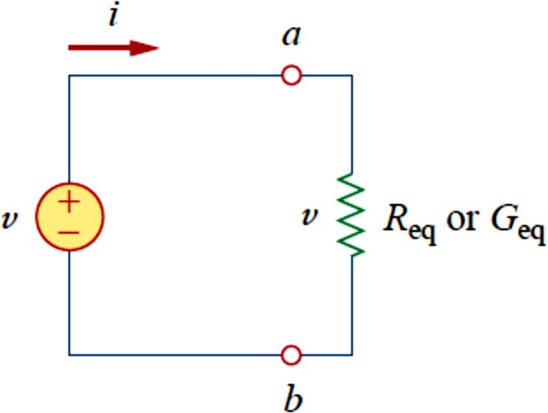
6
It is often more convenient to use conductance rather than resistance when dealing with resistors in parallel. From Eq. (15), the equivalent conductance for N resistors in parallel is
𝐺_{𝑒𝑞} = 𝐺₁ + 𝐺₂ + 𝐺₃ + ⋯ + 𝐺_{𝑁} (17)
The equivalent conductance of resistors connected in parallel is the sum of their individual conductances.
Thus the equivalent conductance 𝐺_{𝑒𝑞} of N resistors in series (such as shown in Fig. 1) is
1 1 1 1 1
𝐺
= _{𝐺} + _{𝐺} + _{𝐺} + ⋯ + _{𝑅} (18)
𝑒𝑞 1 2 3 𝑁
Given the total current 𝑖 entering node a in Fig. 4, how do we obtain current 𝑖₁ and 𝑖₂? We know that the equivalent resistor has the same voltage, or
Fig. 4
𝑣 = 𝑖𝑅 =
𝑖𝑅₁𝑅₂
(19)
𝑒𝑞
𝑅₁ + 𝑅₂
Combining Eqs. (10) and (18) results in
𝑖 =
𝑅₂𝑖
𝑅₁𝑖
𝑖 =
(20)
1
𝑅 + 𝑅 ,
1 2
2
𝑅 + 𝑅
1 2

Slide 7
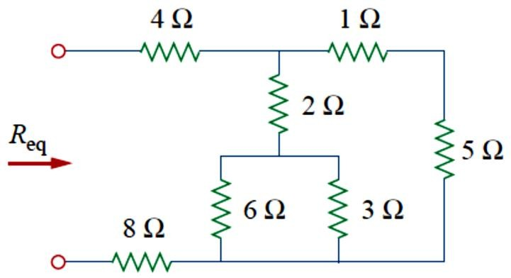
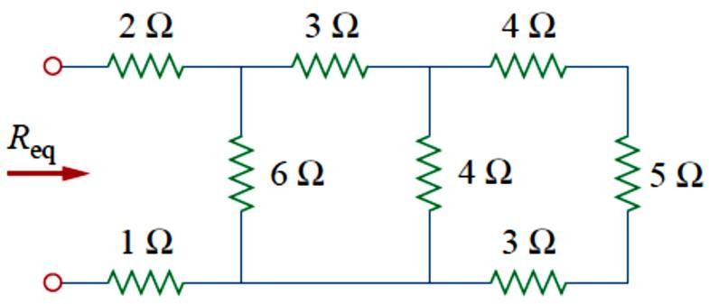
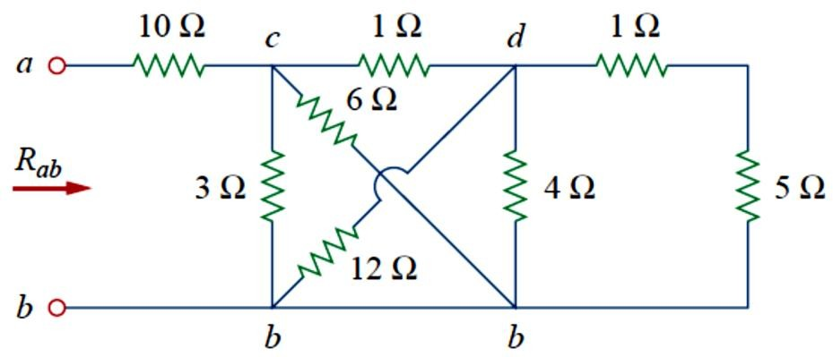
7
Example 1: Find 𝑅_{𝑒𝑞} for the circuit shown in Fig. 5.
Fig. 5
Example 2: Find 𝑅_{𝑒𝑞} for the circuit shown in Fig. 6.
Fig. 6
Example 3: Find 𝑅_{𝑒𝑞} for the circuit shown in Fig. 7.
Fig. 7

Slide 8
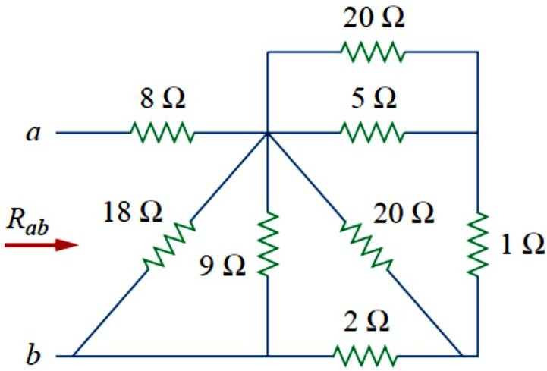
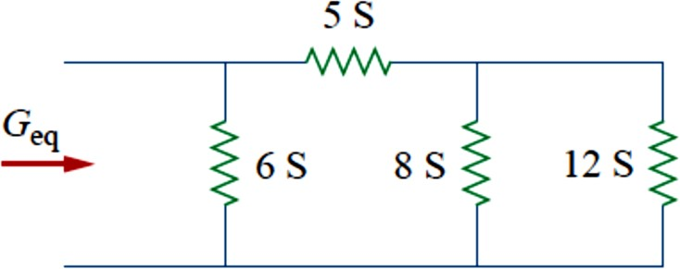
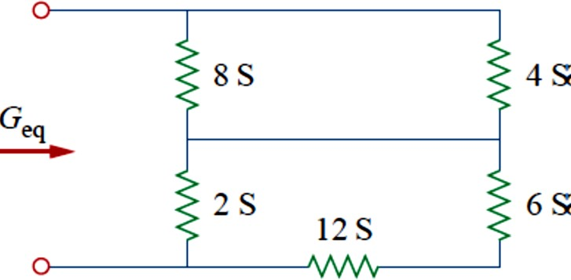
8
Example 4: Find 𝑅_{𝑎𝑏} for the circuit shown in Fig. 8.
Fig. 8
Example 5: Find 𝐺_{𝑒𝑞} for the circuit shown in Fig. 9.
Fig. 9
Example 6: Find 𝐺_{𝑒𝑞} for the circuit shown in Fig. 10.
Fig. 10

Slide 9
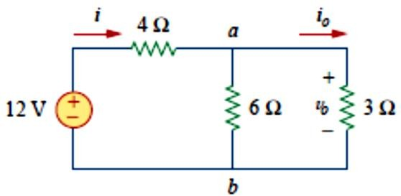
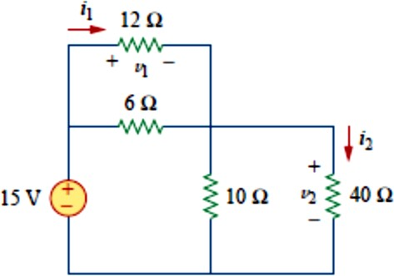
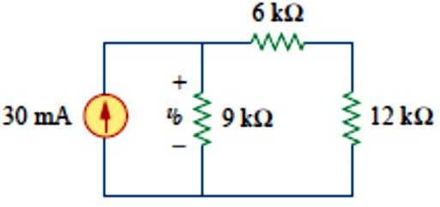
9
Example 7: Find 𝒊_{𝒐} and 𝒗_{𝒐} in the circuit shown if Fig. 11. Calculate the power dissipated in the 3Ω resistor.
Fig. 11
Example 8: Find 𝒗_{𝟏} and 𝒗_{𝟐} in the circuit shown if Fig. 12. Also Calculate 𝒊_{𝟏} and 𝒊_{𝟐} and the power dissipated in the 12-Ω and 40-Ω resistors.
Fig. 12
Example 9: For the circuit shown in Fig. 13, determine: (a) the voltage
𝒗_{𝒐}, (b) the power supplied by the current source, (c) the power absorbed by each resistor.
Fig. 13

Slide 10
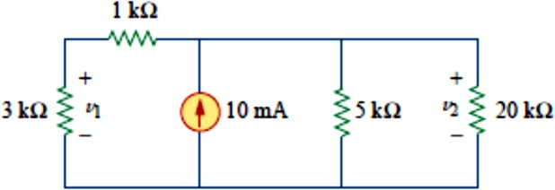
10
Example 10: For the circuit shown in Fig. 14, find: (a) 𝒗_{𝟏} 𝒂𝒏𝒅 𝒗_{𝟐} , (b) the power dissipated in the 3-kΩ, resistors and (c) the power supplied by the current source.

